Slide 1
POD Conference
November 2023
Coaching Meets Pedagogy: How Coaching Can Improve Teaching and Learning
Gypsy Denzine
Professor of Educational Leadership
Virginia Commonwealth University
Rebecca P. Campbell
Professor of Curriculum & Instruction
New Mexico State University

Slide 2
SESSION AGENDA
Introductions (small groups)
What is coaching?
Coaching Mindset
Curiosity
Care
Connection
What is the appetite for a coaching mindset on your campus?

Slide 3
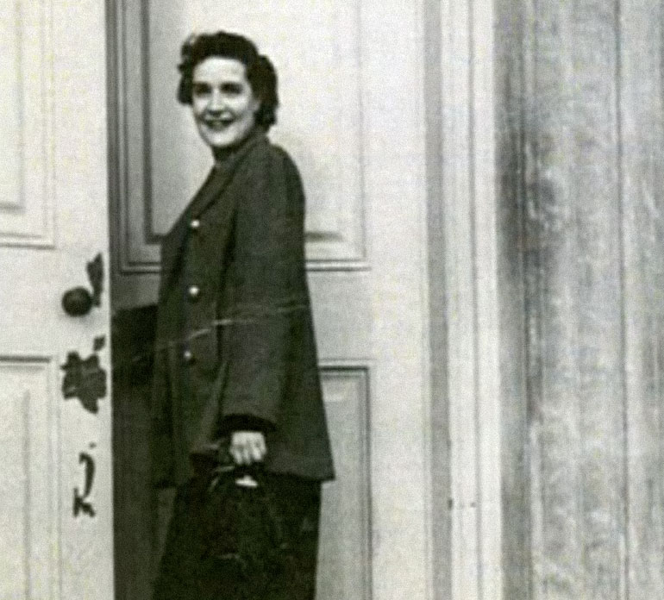
“Learning can occur without teaching—and often does—but teaching cannot occur without learning; teaching without learning is just talking.”
Dr. K. Patricia Cross
1926-2023

Slide 4
Introductions (in pairs)
In the last two years in your role, what are you most proud of?

Slide 5
What is your knowledge of and experience with coaching? (small group discussion)
Are you a coach?
Have you ever experienced coaching as a client?
What are your assumptions and beliefs about coaching?
How is your campus leveraging coaching?

Slide 6
Our stories…
How becoming a coach has improved our teaching.

Slide 7
What is Coaching?
Demo (volunteer)
Definition
Do’s and Don’ts of Coaching

Slide 10
Mentoring,
Consulting, Counseling
Coaching
Lots of listening
Client driven
Client knows best
Forward thinking
Strengths-based
Challenging
Goal setting
Accountability
Maintains appropriate confidentiality
Could give advice
Could give opinions or feedback
You can share your stories
You may actually know best
Maintains appropriate confidentiality

Slide 11
Faculty Example: I am anxious in the classroom.
Coaching
What does anxiety in the classroom look like?
Mentoring
Do you have a poor teaching evaluation? When I’m anxious in class I just focus on my lecture notes.
Teaching
It’s probably just imposter syndrome! Come to this faculty development workshop.
Counseling
Is your classroom anxiety causing problems with eating or sleeping? I think you might benefit from counseling.

Slide 12
A bit of caution…. the “slimy” side of coaching (GD)

Slide 15
Coaching Mindset
Curiosity
Care
Connection

Slide 16
How does a coaching mindset help us?

Slide 17
Important!
Utilizing coaching skills does not mean we are “coaching” students!

Slide 18
Mindset Component 1: Curiosity

Slide 19
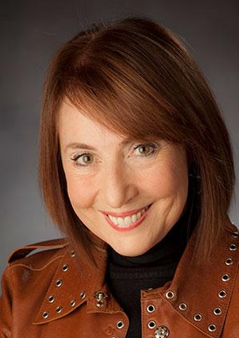
What to ask learners?

Slide 20
Mindset Component 2: Care

Slide 21
OUR TEACHING AND LEARNING SPACE
An Ethic of Care
Not only do I genuinely care about your learning and professional growth, I care deeply about you and your well-being. There can be many things that happen in our lives that can make learning difficult. For example, we know students experience housing challenges and/or food insecurities. If you are having trouble with your basic security needs, please know we have resources on campus to help you. I encourage you to reach out to our Dean of Students office for more information about available resources at VCU. I will also do my absolute best to provide a welcoming and safe learning environment. Again, I care about your well-being. I have most recently designed my leadership practices and EDLP courses to align with the recommendations from the U.S. Surgeon General’s office regarding well-being and equity.

Slide 23
Mindset Component 3: Connection

Slide 24
Great debate: Care or coddling?
How flexible should faculty be?
Should faculty give reminders?
Costs of caring too much?
What academic policies do you have in support a culture of care?

Slide 25
Infusing a coaching mindset into your CTL
What might this look like on your campus?
What do you already have in place that would support this initiative?
What would be the barriers?
Who might be your partners in this effort?

Slide 26
Getting started….
A coaching audit—Who are the coaches on your campus? Their training?
Do you have a student academic coaching program- if yes, heads-up
Appetite for coaching on your campus- dig around Provost’s Office (PIP)

Slide 27
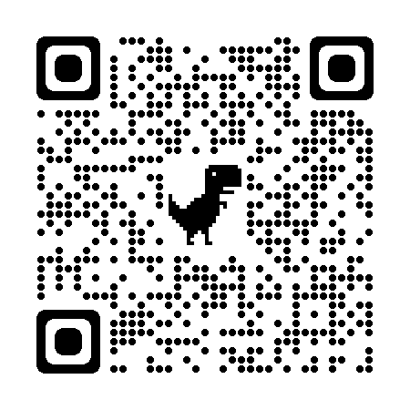
CONTACT INFO
Gypsy Denzine
gmdenzine@vcu.edu
https://practice.do/me/gypsy-denzine
Rebecca Campbell
rjpc@nmsu.edu
https://www.rebeccacampbellphd.com/
Presentation Resources

