Slide 1
Intersections Of Course Policy With Inclusion, Pedagogy, And Learning Outcomes
Rebecca Campbell
Faculty Fellow
Division Of Student Success
New Mexico State University

Slide 2
Our Session Goals are to . . .
Deepen our understanding of the intersection of course policies with our pedagogical values.
Create pathways to use our awareness of the intersection between course policies and our pedagogical values for educational development work on their campuses.

Slide 3
Agenda
Agenda and Goals ~ 5 min
The Big Ideas and A Group Think ~ 10 min
Community Agreements and the Roundtable Charge ~5 min
Roundtable Work ~ 20
Whole Group Wrap-Up ~ 20
Roundtable Presentations ~10
Values Revisited ~15

Slide 4
The Premise
Expectations for course syllabi are substantial: | There are boundaries: | Design aspects:
University requirements – policy statements, specific elements (e.g. credits, course description) Department requirements – office hours, branding Curriculum requirements – student learning outcomes | A semester has time boundaries A course has student learning outcome boundaries | Graphic 1 page/Info graphic styles tone

Slide 5
Design aspects What are all of things recommended for a syllabus to be inclusive, welcoming or motivational?

Slide 6
Pedagogical Values
Maintains boundaries of the course content.
Honors the learning outcomes.
Designed for the learning outcomes.
Inclusive Teaching
Student Learning
Course Integrity
Designed for student learning.
Provides students feedback about their learning.
Allows for students to keep up with the pace of learning.
Provides structure.
Mitigates equity gaps.
Includes everyone.

Slide 7
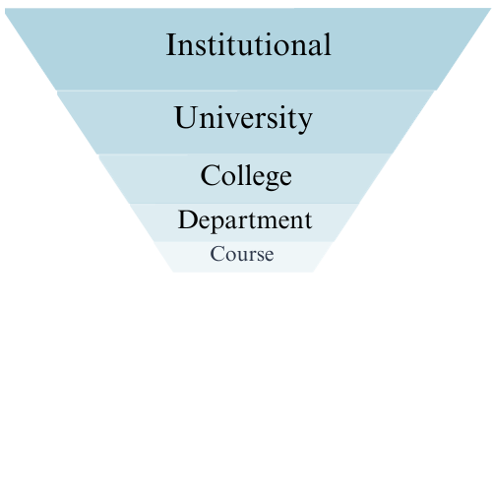
Governance of Academic Policies

Slide 8
Principles and Purpose
Principle: Course policies are based on the principle that if the student successfully engages in the work that is asked of them, and does that work on time, they will be successful in the course.
Purpose: Course policies then, provide the ground rules for how and when students should engage with those pedagogical practices.

Slide 9
Community Expectations
Introduce yourself
Share your pronouns
Respectful dialogue
Speak from your experience
Use the Handout
Others?

Slide 10
Group Example – Admin Drops
How might course integrity be impacted by the boundaries of the course policies?
Practicum experiences require a certain number of hours.
Is virtual shadowing the same as in person shadowing?
What are some examples where the policy is consistent/inconsistent with student learning?
Inconsistent – letting students begin fieldwork late.
Inconsistent – letting students take the course when the don’t meet the pre-reqs
Consistent – using a pre-test to determine readiness prior to admin drop
Consistent – dropping students who don’t sign into LMS
How does the policy foster the inclusion of all students? Does the policy create equity gaps?
Will the students be able to take the course next semester?
Was money a factor in not being ready to take the course?
Admin Drops

Slide 11
Round Table Discussion Questions
How might course integrity be impacted by the boundaries of the course policies?
What are some examples where the policy is consistent/inconsistent with student learning?
How does the policy foster the inclusion of all students?
Late Work
Documentation
Missed Exams
Participation
Attendance

Slide 12
Round Table Reports
Late Work
Documentation
Missed Exams
Participation
Attendance

Slide 13
Values REvisited
Maintains boundaries of the course content.
Honors the learning outcomes.
Designed for the learning outcomes.
Inclusive Teaching
Student Learning
Course Integrity
Designed for student learning.
Provides students feedback about their learning.
Allows for students to keep up with the pace of learning.
Provides structure.
Mitigates equity gaps.
Includes everyone.

Slide 14
Whole Group Wrap Up
What are our next steps?
What are some ways to engage faculty around this topic?
What might really get them excited?
What might really be sticky?

Slide 15
Walk Away Message

Slide 16
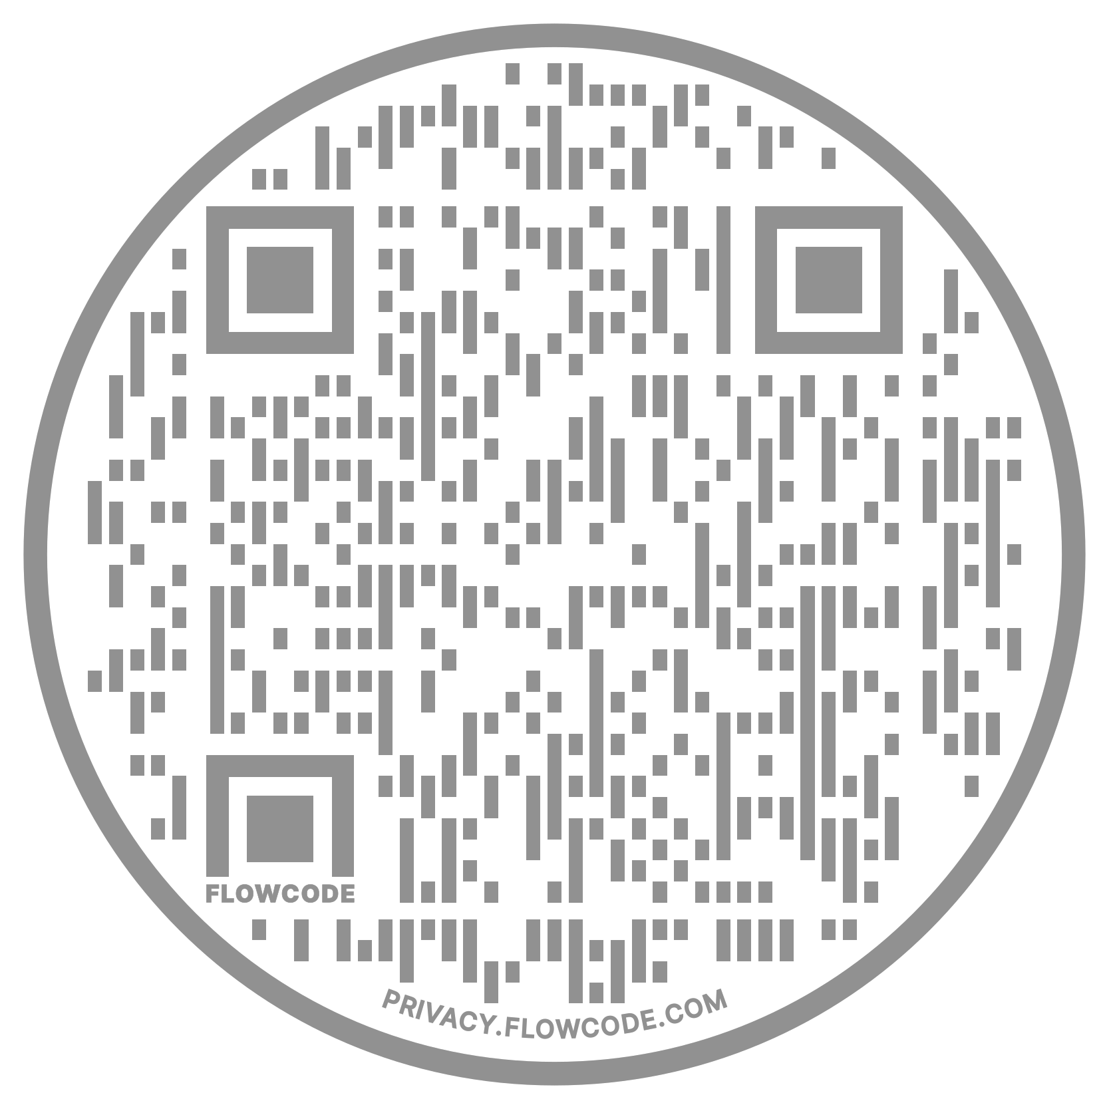
Thank You and Follow-up

